Slide 1
IBM DATA SCIENCE PROFESSIONAL CERTIFICATE · APPLIED DATA SCIENCE CAPSTONE
Predicting Falcon 9
First-Stage Landing Success
An end-to-end pipeline — data collection, EDA, interactive analytics, and machine-learning prediction of booster recovery.
Oleksandr Shvydkyi
Repository: github.com/aashkval/ibm-ds-ps-capstone-spacex

Slide 2
AGENDA
Outline
01
Executive summary
Methods and headline results at a glance
02
Introduction
Why first-stage recovery drives launch cost
03
Methodology
Collection, wrangling, EDA, interactive analytics, modeling
04
Results
SQL & visual EDA, Folium map, Plotly Dash dashboard
05
Predictive analysis
Four classifiers compared; best model & confusion matrix
06
Conclusions
Insights and what they mean for a competitor
IBM Data Science Capstone · Falcon 9 First-Stage Landing Prediction
2

Slide 3
EXECUTIVE SUMMARY
What we did and what we found
Approach
Collected Falcon 9 launch records from the SpaceX REST API and Wikipedia; wrangled them into a labelled dataset; explored the drivers of landing success with SQL and visualization; built an interactive Folium map and a Plotly Dash dashboard; and trained four classifiers to predict first-stage landing.
Key findings
Landing success rises with flight experience and varies sharply by orbit and site
KSC LC-39A is the most successful launch site
All four models reach ~83% test accuracy; SVM leads on cross-validation
Landing — hence ~ launch cost — is predictable from public launch attributes
90
4
0.83
100
Falcon 9 launches
ML models compared
best test accuracy
successful missions
IBM Data Science Capstone · Falcon 9 First-Stage Landing Prediction
3

Slide 4
INTRODUCTION
Background & problem statement
SpaceX advertises Falcon 9 launches at about $62M, against $165M+ for competitors — largely because it recovers and reuses the first stage. Whether that stage lands successfully therefore drives a large share of the cost of a launch.
COST OF A LAUNCH
$62M
SpaceX Falcon 9 (reusable first stage)
Problem
Given a planned launch (payload mass, target orbit, launch site, booster version, flight number, reuse history), can we predict whether the Falcon 9 first stage will land?
A reliable prediction lets a competitor estimate the true cost of a launch and inform its bid.
$165M+
Typical competitor (expendable)
The savings come from recovering the booster — so predicting the landing predicts the cost.
IBM Data Science Capstone · Falcon 9 First-Stage Landing Prediction
4

Slide 5
METHODOLOGY · 1 OF 6
Data collection — SpaceX REST API
GET /launches/past
→
Normalize JSON → DataFrame
→
Enrich rocket / payload / core
→
Filter to Falcon 9
→
Impute PayloadMass
Issued a GET request to the SpaceX v4 API and flattened the JSON with pandas json_normalize.
Used identifier columns to fetch booster name, payload mass & orbit, launch-site coordinates, and core/landing details.
Restricted to Falcon 9 and imputed missing PayloadMass with the column mean → 90 launches, 0 nulls.
🔗 notebooks/1 — data collection (API)
IBM Data Science Capstone · Falcon 9 First-Stage Landing Prediction
5

Slide 6
METHODOLOGY · 2 OF 6
Data collection — web scraping
Request Wikipedia snapshot
→
Parse with BeautifulSoup
→
Extract table headers
→
Iterate rows → launch_dict
→
Build DataFrame → CSV
Requested a fixed Wikipedia snapshot (oldid 1027686922) of the Falcon 9 / Falcon Heavy launch list for reproducibility.
Parsed the launch table with BeautifulSoup, extracting column names from the headers and cell values row by row (with None-guards for missing links).
Assembled the records into a DataFrame → spacex_web_scraped.csv (121 rows).
🔗 notebooks/2 — web scraping
IBM Data Science Capstone · Falcon 9 First-Stage Landing Prediction
6

Slide 7
METHODOLOGY · 3 OF 6
Data wrangling & label engineering
Count launches / orbits
→
Tabulate landing outcomes
→
Map 8 outcome strings
→
Derive Class (1/0)
→
Export dataset_part_2
Summarized launches per site and per orbit, then counted the eight textual landing outcomes (True/False/None × Ocean/RTLS/ASDS).
Created the binary training label Class — 1 when the booster landed successfully, 0 otherwise — by mapping the “bad” outcomes to 0.
Overall success rate in the dataset ≈ 0.67; result saved as dataset_part_2.csv.
🔗 notebooks/3 — data wrangling
IBM Data Science Capstone · Falcon 9 First-Stage Landing Prediction
7

Slide 8
METHODOLOGY · 4 OF 6
EDA with visualization & feature engineering
Scatter relationships
→
Bar: success by orbit
→
Line: yearly trend
→
One-hot encode features
→
Export dataset_part_3
Visualized landing outcome against flight number, payload mass, launch site and orbit (scatter), success rate by orbit (bar), and the success trend by year (line).
Engineered the model feature matrix: selected predictors and one-hot encoded Orbit, LaunchSite, LandingPad and Serial, casting all columns to float64.
Result: a fully numeric 90 × 80 matrix saved as dataset_part_3.csv.
🔗 notebooks/4 — EDA with visualization
IBM Data Science Capstone · Falcon 9 First-Stage Landing Prediction
8

Slide 9
METHODOLOGY · 5 OF 6
EDA with SQL
Loaded the launch dataset into a SQLite table and answered ten analytical questions with SQL:
Unique launch sites; first records for sites beginning “CCA”
Total & average payload mass (NASA CRS; booster F9 v1.1)
First successful ground-pad landing; boosters with success in 4,000–6,000 kg range
Counts of successful vs. failed missions; max-payload boosters (subquery)
2015 failed drone-ship landings by month; ranked landing outcomes 2010–2017
🔗 notebooks/5 — EDA with SQL
IBM Data Science Capstone · Falcon 9 First-Stage Landing Prediction
9

Slide 10
METHODOLOGY · 6 OF 6
Interactive analytics — Folium & Dash
Folium map
Plotly Dash dashboard
Plotted all four launch sites with markers
Color-coded success / failure via MarkerCluster
Measured distances to coastline, railway, highway and city using a Haversine helper
Dropdown to select all sites or one site
Pie chart of success share / per-site outcomes
Payload range slider with an outcome scatter colored by booster version
🔗 notebooks/6 — Folium map
🔗 spacex_dash_app.py
IBM Data Science Capstone · Falcon 9 First-Stage Landing Prediction
10

Slide 11
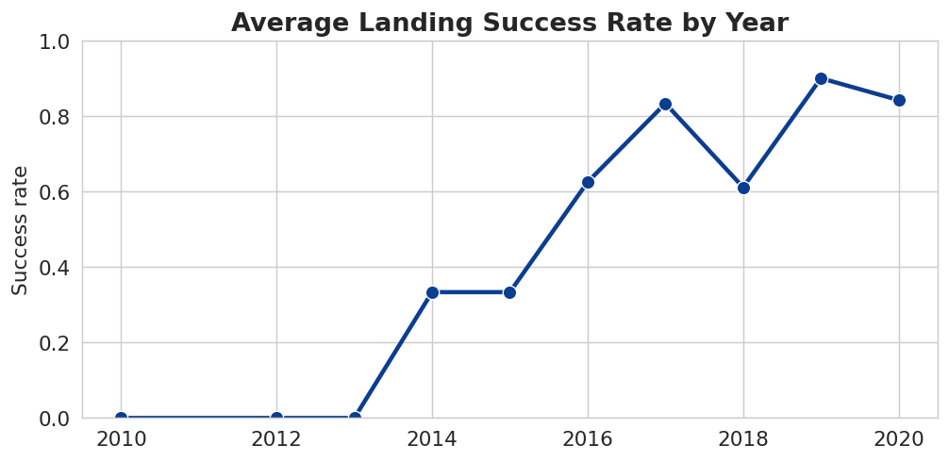
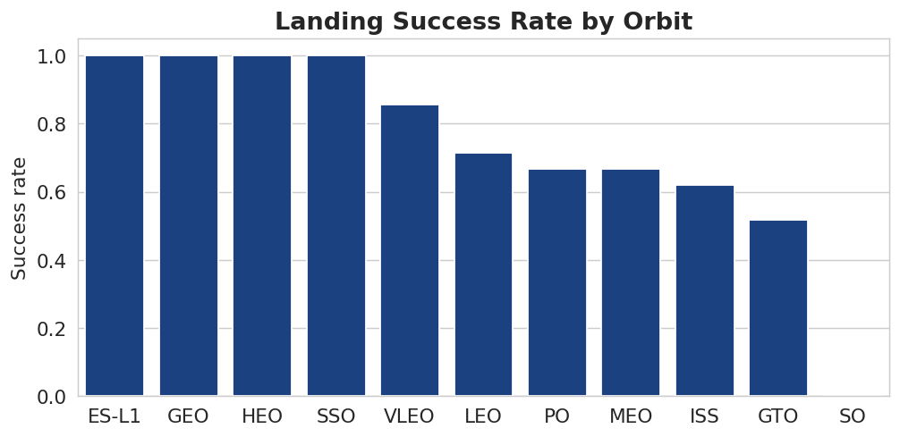
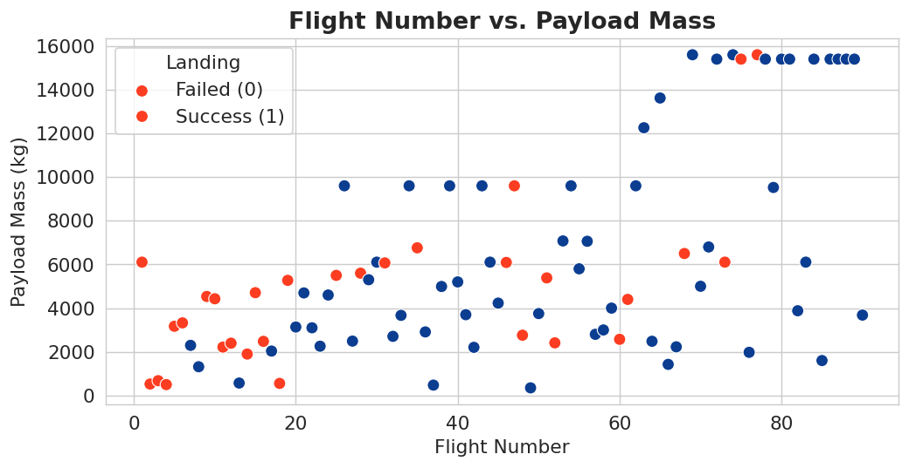
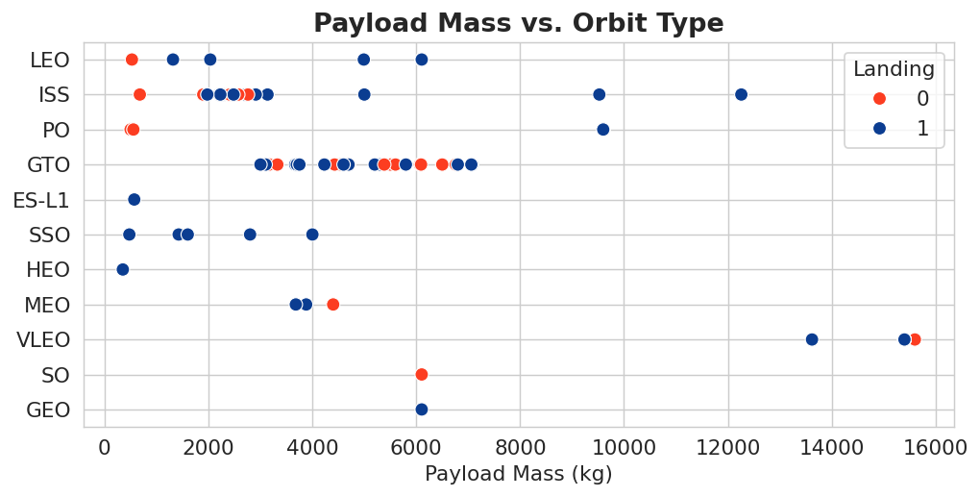
RESULTS · VISUALIZATION
What the charts reveal
Success climbs over time and with flight number; it is strongly orbit-dependent (ES-L1/GEO/HEO/SSO high) and best for lighter payloads.
IBM Data Science Capstone · Falcon 9 First-Stage Landing Prediction
11

Slide 12
RESULTS · SQL
Key query findings
Question | Result
Unique launch sites | CCAFS LC-40 · CCAFS SLC-40 · KSC LC-39A · VAFB SLC-4E (4)
Total payload mass — NASA (CRS) customers | 45,596 kg
Average payload mass — booster F9 v1.1 | 2,928.4 kg
First successful ground-pad landing | 2015-12-22
Successful vs. failed mission outcomes | 100 successful · 1 failure
Boosters carrying the maximum payload (15,600 kg) | Starlink B5 cores (B1048/B1049/B1051/B1060 …)
Failed drone-ship landings in 2015 | 2 (January & April, CCAFS LC-40)
🔗 notebooks/5 — EDA with SQL
IBM Data Science Capstone · Falcon 9 First-Stage Landing Prediction
12

Slide 13
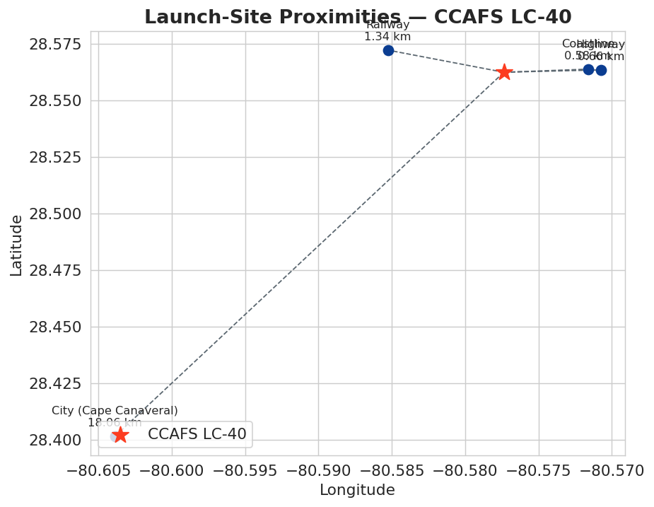
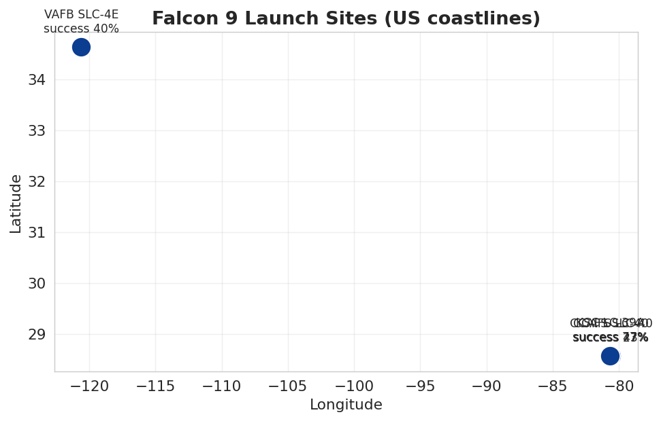
RESULTS · FOLIUM
Launch-site geography & proximities
All sites sit on coasts at low latitude. For CCAFS LC-40: coastline 0.58 km, highway 0.66 km, railway 1.34 km, nearest city 18.06 km — close to transport, set back from population.
IBM Data Science Capstone · Falcon 9 First-Stage Landing Prediction
13

Slide 14
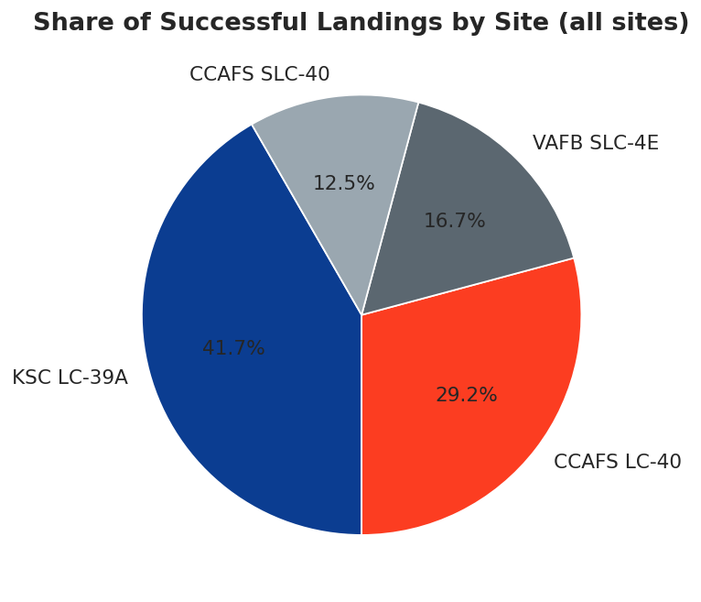
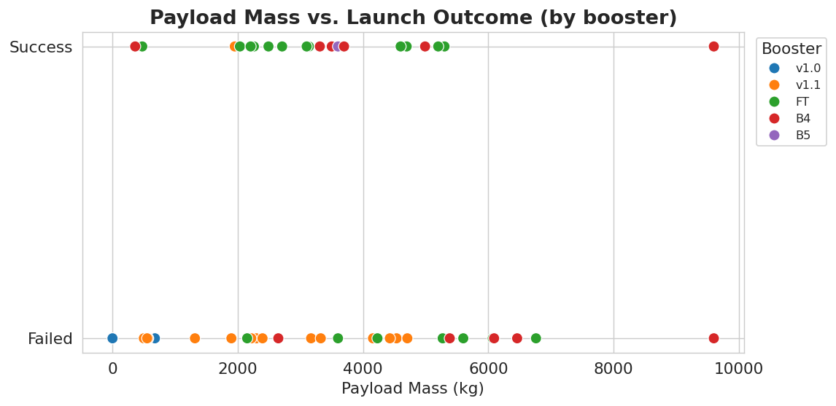
RESULTS · DASH
Dashboard insights
Most successful site
KSC LC-39A
Worst payload band
6,000–8,000 kg → 0%
Best booster
FT ≈ 67% success
IBM Data Science Capstone · Falcon 9 First-Stage Landing Prediction
14

Slide 15
PREDICTIVE ANALYSIS · 1 OF 2
Comparing four classifiers
Setup
Standardized 80-feature matrix; 80/20 train-test split (random_state = 2); GridSearchCV with 10-fold CV per model.
Read-out
Three of four models tie at 0.833 on the 18-sample test set. SVM has the highest cross-validation score (0.848).
🔗 notebooks/7 — predictive modeling
IBM Data Science Capstone · Falcon 9 First-Stage Landing Prediction
15

Slide 16
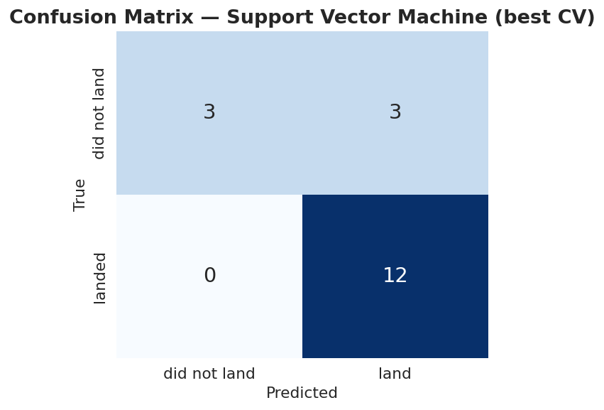
PREDICTIVE ANALYSIS · 2 OF 2
Best model — confusion matrix
Support Vector Machine
12 true positives — landings predicted correctly
3 true negatives — non-landings predicted correctly
3 false positives — predicted landing, did not land
0 false negatives — none missed
The model never misses an actual landing; its only errors are false alarms. Accuracy on the held-out set is 15 / 18 = 0.833.
IBM Data Science Capstone · Falcon 9 First-Stage Landing Prediction
16

Slide 17
CONCLUSIONS
What the analysis tells us
1
Recovery is a learning curve Landing success rose steadily year over year and with cumulative flight number — early failures gave way to routine recoveries.
2
Mission profile decides the odds Success depends strongly on orbit type and payload mass; lighter payloads and orbits such as ES-L1, GEO, HEO and SSO land most reliably.
3
Site & booster matter KSC LC-39A is the most successful site and the FT-generation boosters recover most often.
4
Prediction works — with a caveat Four classifiers reach ~83% test accuracy (SVM best on CV). With only 18 test samples the models are effectively tied; more data is needed to separate them.
5
Business takeaway Landing — and therefore the ~$100M cost gap per launch — can be predicted from public attributes, directly informing a competitor's bid.
IBM Data Science Capstone · Falcon 9 First-Stage Landing Prediction
17

Slide 18
Thank you
Full code, notebooks and data:
github.com/aashkval/ibm-ds-ps-capstone-spacex
Oleksandr Shvydkyi · IBM Data Science Professional Certificate — Applied Data Science Capstone

